Slide 1

Tartaruga
Clothing made purely from bamboo.
David Stahr, Student A, Student B, and Student C
Notes:
Hi I’m Alexis Arsenis and this is Madison Rojas and we are from Tartaruga.

Slide 2
Product
Eco- Friendly
No chemicals
Renewable and biodegradable
Made in the USA
Notes:
We at Tartaruga will be producing high quality clothing solely from bamboo. Currently, there are other bamboo clothing and fabrics on the market, however these companies use harmful chemicals to break down bamboo stalks into workable fibers. We are unique because we use an eco-friendly mechanical process to create our clothes. Now you may ask, why bamboo? The answer is that bamboo is an extremely renewable resource that does not need pesticides to thrive. Additionally, our product stands out from competitors because it is made entirely in the United States.

Slide 3
Price
Competitive Prestige Pricing:
Clothing Type | Cost to Produce | Our Selling Price | Cariloha’s Price for Same Product | Our Profit
Men’s Button-down Shirt | $29.91 | $69.99 | $80 | $40.08
Notes:
Our price will be competitive compared to our biggest competitor, Cariloha which is a company that produces bamboo clothing using chemicals. Both of our companies use prestige pricing to attract affluent customers, who are willing to spend the extra dollar for quality. We will use the psychological pricing strategy to make our prices seem lower than they actually are. For example, we calculated that it will cost about thirty dollars to produce a men’s button-down shirt, and we will sell it for 69.99, a full ten dollars cheaper than Cariloha’s button-down, and we will still make a forty dollar profit. We know based on Cariloha’s success that our target market is willing to spend a significant amount of money for these products, and we will attract more customers because we will sell it slightly lower, and with more benefits to the environment.

Slide 4
Promotion Strategy
College Campus’
Youtube
Magazine
Social Media
Notes:
At our Providence location, there are a total of 5 local colleges. There is Brown University, Providence College, RISD, Johnson and Wales University, and Rhode Island Community College. Between the 5 colleges there is a total of 33,859 students. So the best ways for us to reach out to these students will be to place flyers, like the ones we have passed out to you, all over those campus’, to grab the eyes of our future customers! We will also promote our brand by investing money into YouTube advertisements. We will pay for each view, so we will be able to choose the amount of exposure that we will receive. Additionally we will promote our store in Motif Magazine, which distributes throughout Rhode Island to our target demographic. Of course, marketing to a younger demographic would not be complete without making good use of the major social media platforms.
Motif magazine

Slide 5
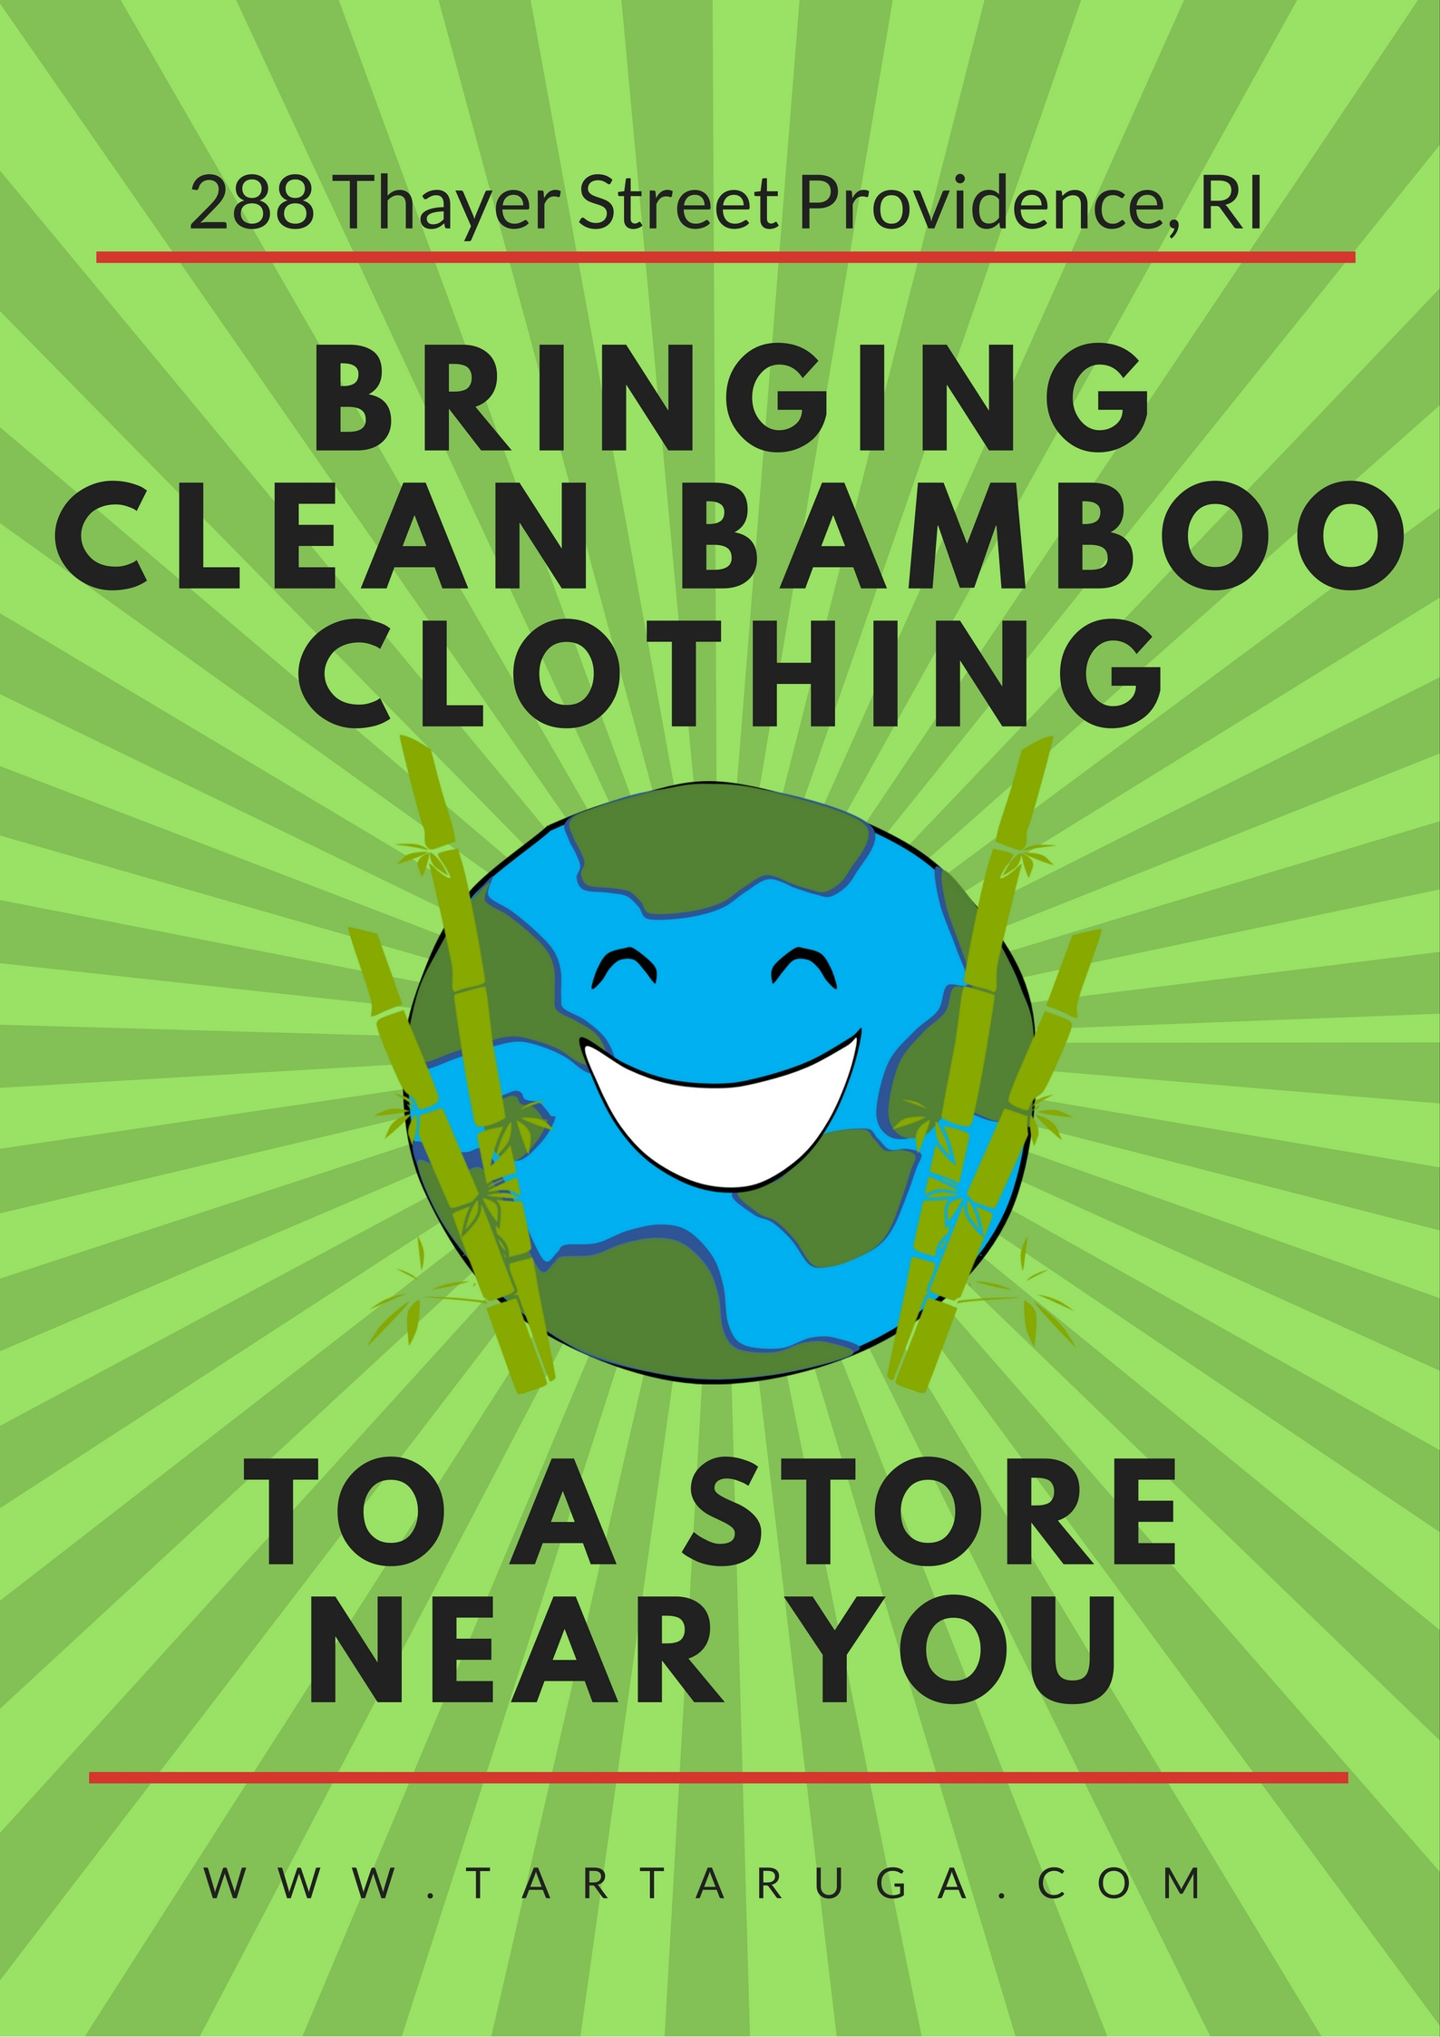

Notes:
This an example of the flyer we will be distributing to college campuses as well as the advertisement we will pay for in Motif Magazine.

Slide 6
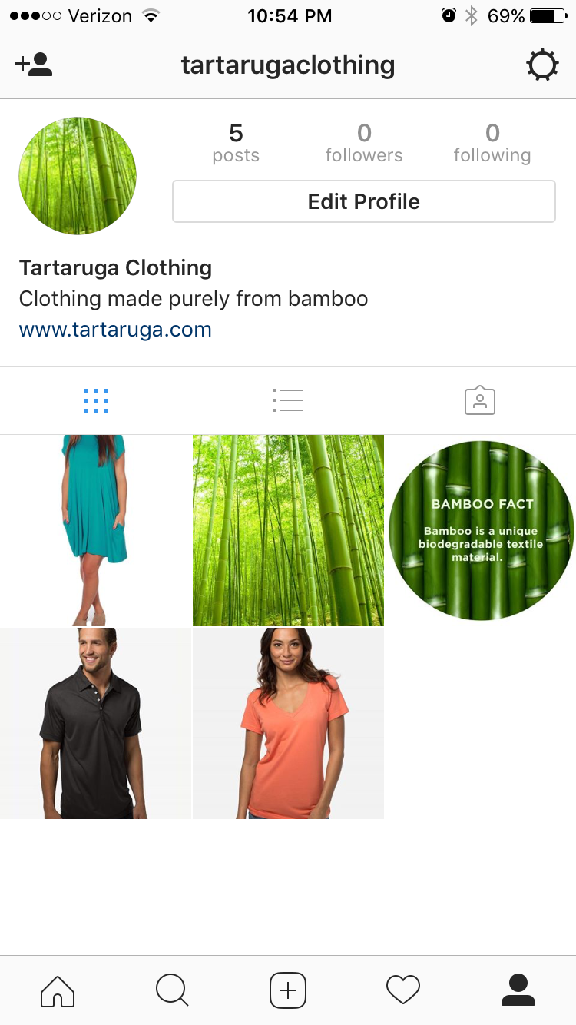
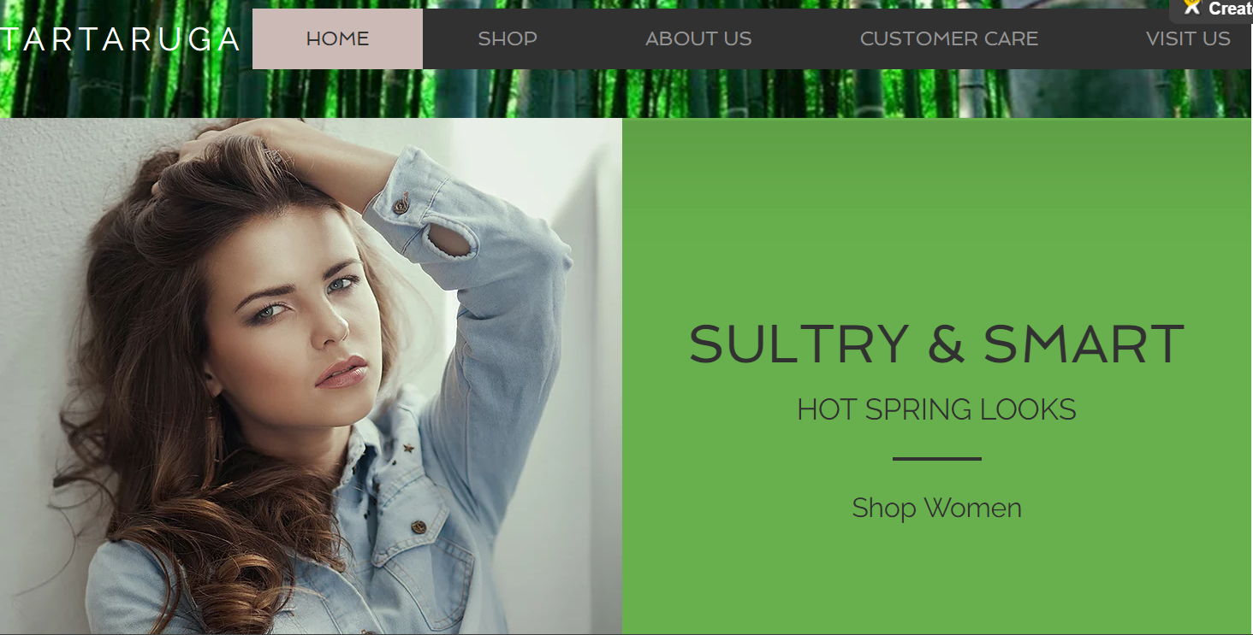
Notes:
These are images from our instagram page and our Webpage

Slide 7
Place
Retail stores:
288 Thayer Street Providence, R.I.
7 Via Albricci, Milan, Italy
Our website: www.tartaruga.com
Notes:
Alexis: As I said earlier we have two locations one in providence and one in Milan

Slide 8
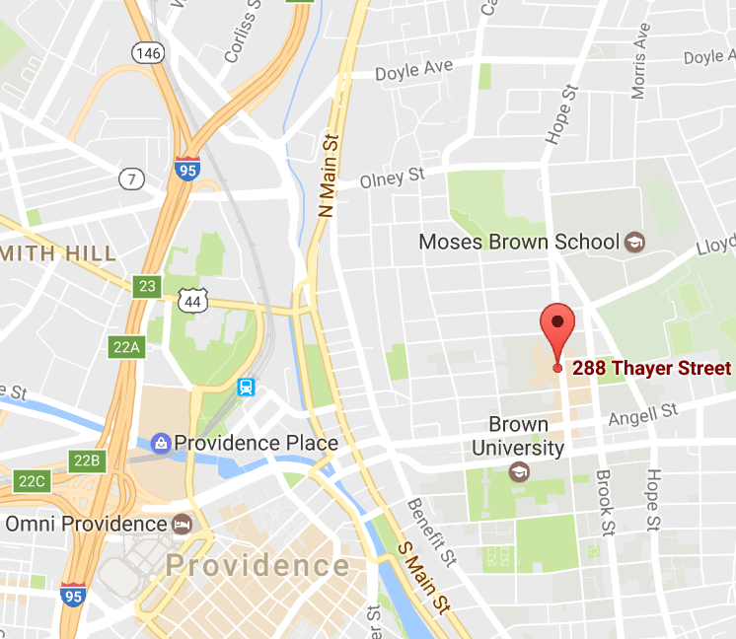
Optimal Providence Location
Notes:
Alexis: As you can see the placement of our store is right near Brown University, and is very convenient for our consumers, therefore we will receive more business.
Since its just a one minute drive away

Slide 9
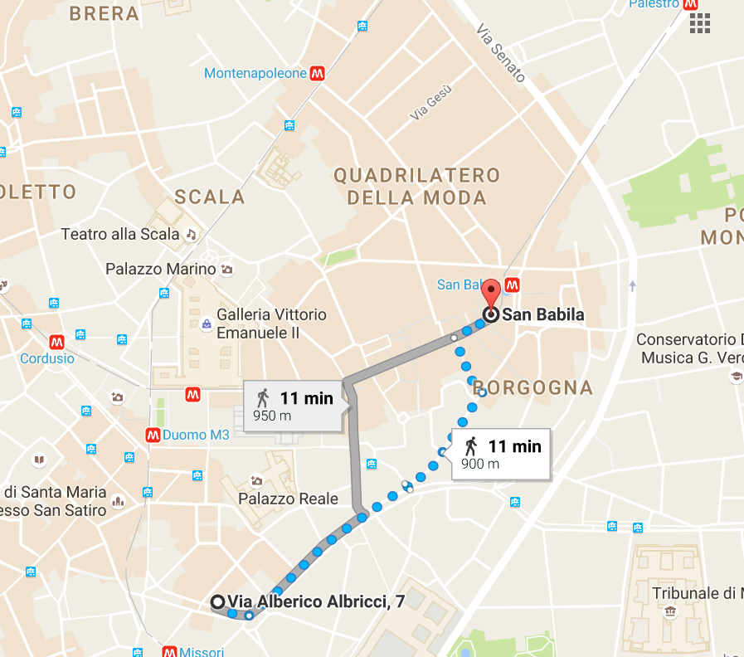
Optimal Italian Location
Notes:
Alexis: Our Italian location is also in the perfect location, because it is just an 11 minute walk from the fashion quadrilateral, an area in Milan with high end clothing stores. Our prestige pricing will fit perfectly in this area.

Slide 10
Questions?

